Slide 1
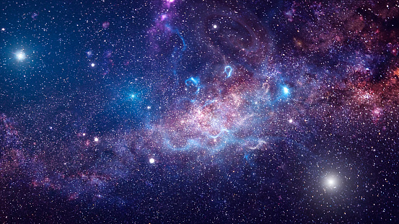
Space Explorer
Exploring space more easily...
Team NPS
Members: Abhinav Karn and Rahul Barman

Slide 2
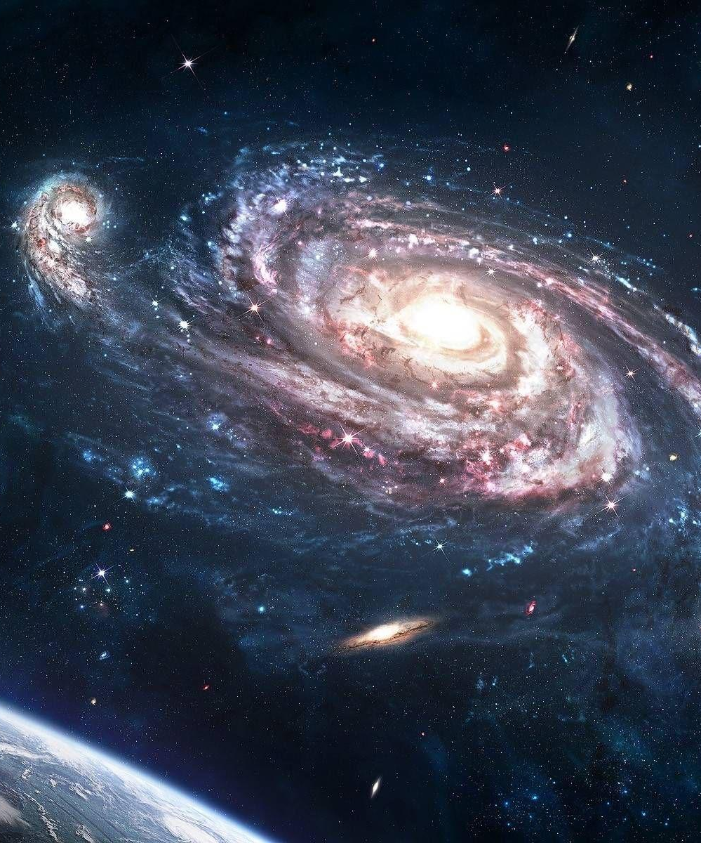
Why have we selected the Space Challenge Theme?
The theme that our team has selected is Explore Space. Space is the three-dimensional continuous expanse that begins where our imagination ends. Not a lot of people know much about it. This is why we chose this theme so that we can propose a small solution to make learning a few things about space more easy for everyone.

Slide 3
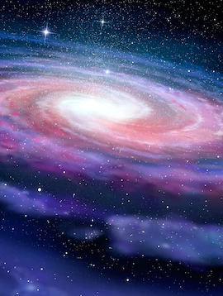
The idea behind our solution
Many people would like to know more about the planets around us. Knowing where we stand in our vast solar system with respect to some other planet and knowing more and more about the celestial bodies around is something really interesting. Although it can often be tedious to find relevant information about this. This is why we decided to propose a solution to easily get this information for the people.

Slide 4
More about our project...
Our project mostly has two parts -- the first is an information gatherer which allows the users to relevant information on any searched topic and the second is a program which shows the position of a planet in our galaxy with respect to earth. For creating both of these projects, we have used Python which is a very popular programming language.

Slide 5
The Information Gatherer
This feature enables the user to gather information on any topic they want to study about, be it science, tech or space. User can select the option of receiving the best and most relevant websites which directly opens in their default browser and the second option is to get the best images of that topic to make the user understand about the topic better. The user can also use both the options at once and thus it becomes a great source of data gathering and studying about new things.

Slide 6
Orbit Viewer
This part of the application calculates the what fraction of the orbit has been completed by a planet and then uses that information to plot the planet in its orbit. The orbits and planets are not to scale but are adjusted to fit the screen. The planet in question is plotted along with Earth in order to relate its position with our planet. Currently it doesn’t have a very high accuracy but we are trying to improve it by finding alternative methods to determine the location of planets in their orbit.

Slide 7
Working of our Project
The code of our project is basically divided into two parts. The first one is the web scraper which collects data according to the users’ command. The web scraper is further divided into an image collector which collects the most relevant and high quality pictures about the searched topic and displays it. Finally there is the data collector which collects data from the web and gathers some URLs about the searched topic and finally opens a few websites which seem to be the most relevant and have the best details about the topic.

Slide 8
Working of our Project
It also provides additional links if the user is interested in studying about the topic more. Both of these functions are performed using the Google Custom Search API and many other libraries such as urllib3, webbrowser, googleapiclient, pillow, datetime, keyboard which help in the proper functioning of the code.

Slide 9
Working of our Project
For the second part, the program utilizes the information on this website in order to locate the orbits of the planets. We have used the Turtle module in python in order to display the results.
Currently, our prototype is able to display the locations of mercury and earth on the day the program is being ran.

Slide 10
Working of our Project
Finally after merging both of these programs together we converted the Python code into a web application to make the interface more user friendly. The web application can only run locally and uses port 1025 to carry out its functions.

Slide 11
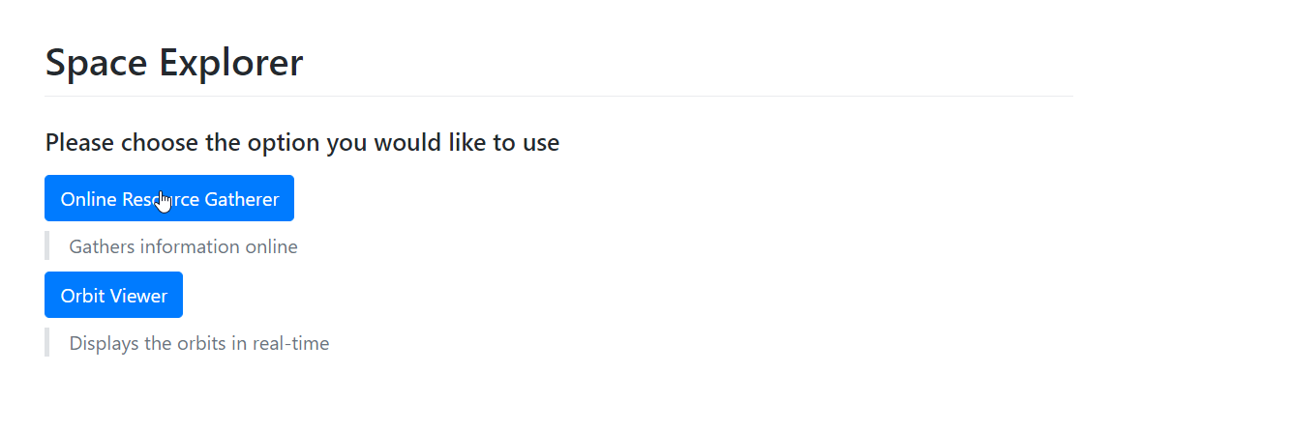
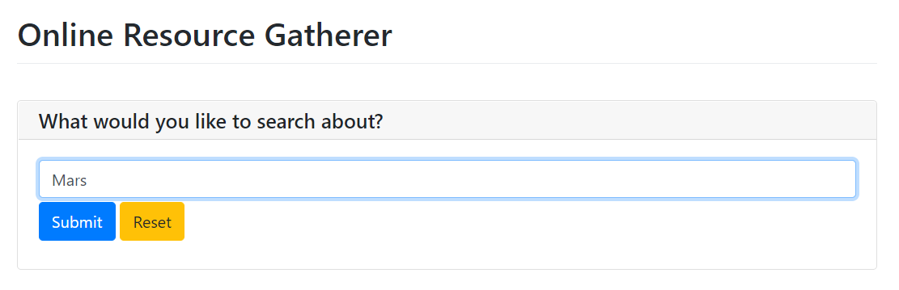
Screenshots of the Prototype

Slide 12
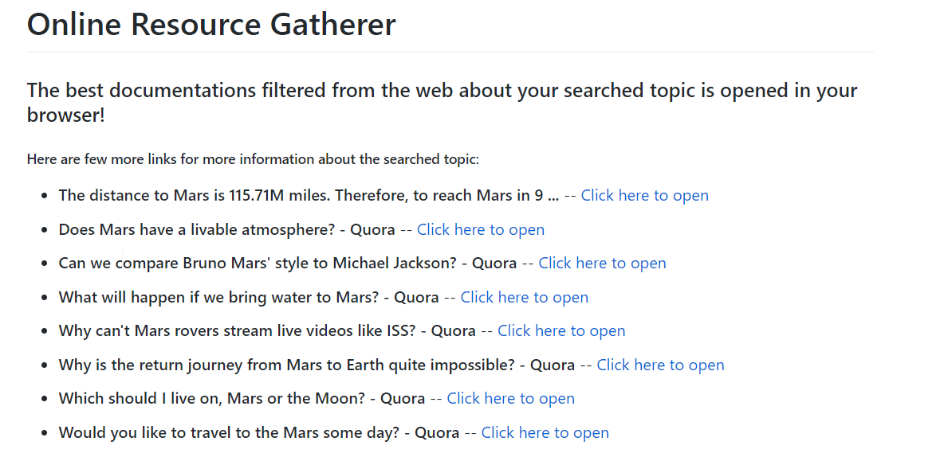
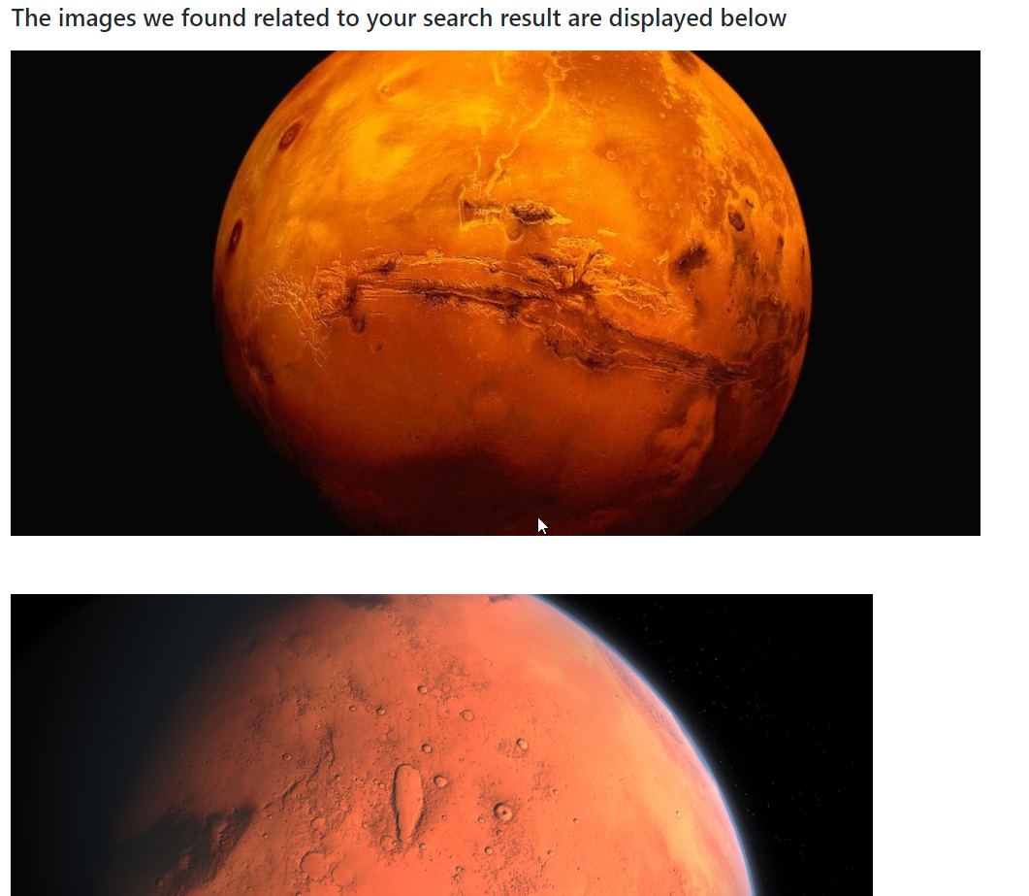
Screenshots of the Prototype

Slide 13
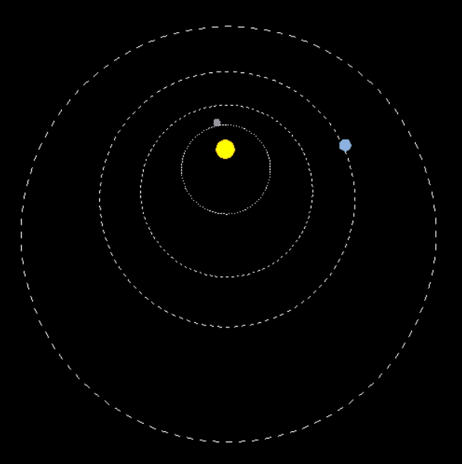
Screenshots of the Prototype

Slide 14
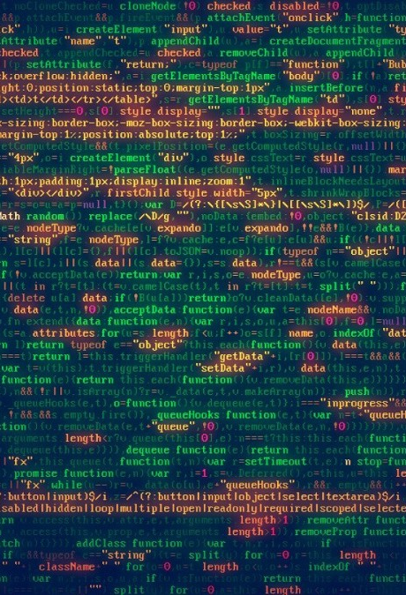
The Code
We have used to GitHub to collaborate with our team members and work on our project. The project can be found on this link.
To use the application, the user must have Python installed and also needs to install a few additional modules. The below given command can be run in the command prompt to download all the necessary modules required for the program to run:
pip install google-api-python-client pywebio

Slide 15
The Code
In order to run the program, the web_app.py program needs to be downloaded and run. This program will start a web application on the port 1025.
Next, the user needs open a web browser and navigate to the 127.0.0.1:1025 where the application is running.

Slide 16
Our project is a one that can help people in gathering information about space and planets in a better and easy way. The prototype can even be modified to be applied in further use cases and can be made into a good learning app.

Slide 17


